Slide 1
The Triumphs and Travails of The Jeffersonian Republic
AP Chapter 11
Mr. Walters

Slide 2
Big Ideas . . .
“Revolution of 1800”
Judicial Role Defined
Jefferson’s principles in question
Who are our friends?
Mr. Madison’s War

Slide 3
Election of 1800
Federalists ran John Adams
Strong central government and law and order
Weakened by Alien and Sedition Acts, peace with France and split with Hamilton
Democratic-Republicans ran Thomas Jefferson
Agrarian, states rights, liberty
Accused of fathering kids with slaves, being antireligious
Jefferson wins, but tied with Burr
3/5 compromise increased southern electoral college votes, with allowed Jefferson to win
Peaceful transfer of power to opposing political force was unprecedented

Slide 4
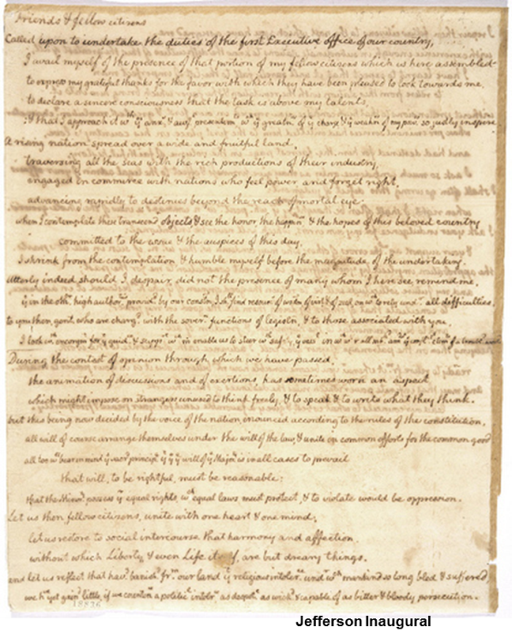
Jefferson’s Presidency
Pursued a moderate course to encourage Federalists to switch parties
Sought to downplay formality of government and eliminate distinctions between class and position
Effort to be more “democratic” in spirit instead of monarchical tendencies of Federalists
Wanted to avoid industrialization and urbanization
Wanted nation based on agriculture
Wanted very limited central government
Cut military and spending to eliminate debt
Secretary of Treasurer Gallatin left most Hamilton policies intact
Alien and Sedition Acts were not renewed
Excise tax on whiskey was repealed

Slide 5
Judiciary Act of 1801
Judiciary Act 1801 created 16 judgeships
Federalists tried to keep control of judicial branch by appointing many judges just before Adams left office “midnight judges”
Jeffersonians saw this as Federalist attempt to keep control of judicial branch also would allow judges to ignore will of people
Jefferson wanted to fill positions from people in his party
Did not deliver notices of appointment after he was sworn in
Patronage is practice of appointing loyal party members as a reward and to build party strength
Democrat-Republicans tried to impeach several judges

Slide 6
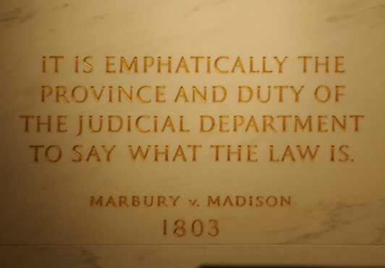
Marbury v. Madison (1803)
Marbury was a midnight judge who did not receive his commission
Sued Secretary of State James Madison to force delivery of commission
Chief Justice Marshall
Used case to establish power of Supreme Court
Ruled section of Judiciary Act was unconstitutional
Established the precedent of judicial review
Supreme Court has authority to review acts of Congress and declare unconstitutional
States tried to claim right to determine constitutionality in Kentucky resolutions (1798)

Slide 7
Impeachment of Samuel Chase
Jeffersonians attempted to impeach Chase as retaliation for Marbury decision
Was acquitted because Congress ruled that an official can only be impeached for treason, bribery or other high crimes or misdemeanors
Made sure that impeachment could not be used as a political tool to get rid of judges

Slide 8
Barbary Pirates
Jefferson had eliminated most military spending to save money and follow republican ideas
Distrusted standing armies – feared it could lead to dictatorships
Barbary States of North Africa sent out pirates to attack ships
Kidnapped ships and held them for ransom
Jefferson sent navy to fight pirates to stop pirates
US gets peace treaty in 1805
Demonstrated America’s ability to defend itself

Slide 9
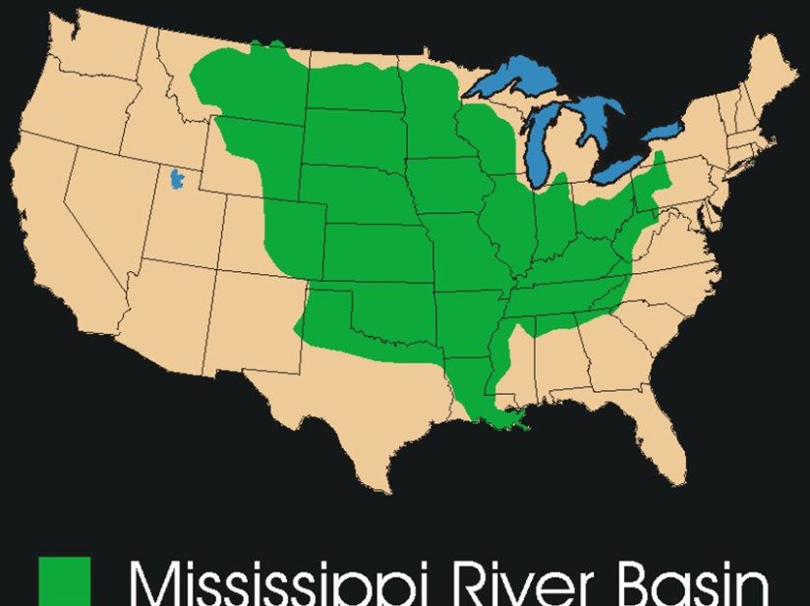
Louisiana
Napoleon takes Louisiana back from Spain in a secret treaty in 1800
Made Americans worried
Westerners depended on access to Mississippi for trade and survival
Jefferson wanted to encourage expansion of farm land in the west
Jefferson sent James Monroe to France to help Robert Livingston buy New Orleans for $10 million
US was not afraid of Spain, but feared power of France
Jefferson warned that the US would ally with England if France denied access to New Orleans

Slide 10
Haitian Revolution and Louisiana Purchase
Haitian Revolution (1791-1803)
Haitians (Santo Domingo) revolt against France during French Revolution
Led by Toussaint L’Ouverture
Haitians fight off French armies and mosquitos with yellow fever killed troops
Napoleon believed he needed Haiti to control Louisiana
Also did not want to encourage America to ally with Britain while France was fighting Britain
Louisiana Purchase (1803)
Napoleon preferred US becoming legitimate global power to help keep Britain in check
Since Napoleon lost Haiti, he decided to sell Louisiana
Monroe and Livingston were not authorized to make purchase
Decided to buy it anyway for $15 million on April 13, 1803
Some believed land was worthless

Slide 11
Jefferson’s constitutional dilemma
Constitution does not say if Congress can buy land
Jefferson believed that Congress can only do what is said in Constitution (strict construction)
Jefferson decided to support the purchase anyway
Discouraged his supporters from talking about constitutional issues in hopes that it wouldn’t be brought up
Didn’t want to wait for amendment for fear offer would be withdrawn
Louisiana doubled the size of the United States
Guaranteed access to Mississippi
Believed it insured success of America and democracy
Allowed for expansion of states across the continent
13 new states would be made from the territory (828,000 acres)

Slide 12
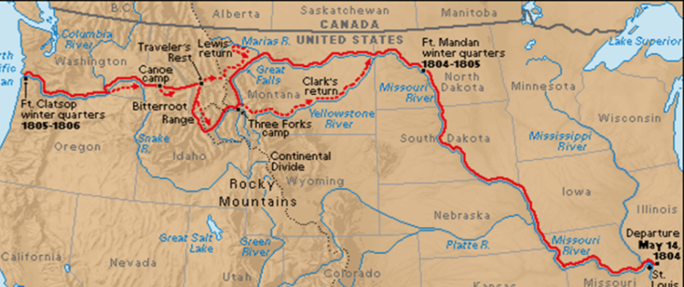
Louisiana Purchase
Effects of Purchase
Precedent established that US can purchase additional land
New lands would create states admitted on equal footing
Allowed Louisiana to keep Napoleonic Code instead of British common law
Allowed America to disengage from Europe because no European power left on North America
Lewis and Clark Expedition (Corps of Discovery)
Americans did not know what was within Louisiana Purchase
led by Meriwether Lewis and William Clark
to find all water route to Pacific, study Indian tribes, nature and the environment
York and Sacajawea helped the expedition
Lewis and Clark left spring 1804 arrived at Pacific December 1805
US claimed Oregon
Expedition gave details of what was in Louisiana

Slide 13
Zebulon Pike
Went west from Mississippi to Rocky Mountains then into Spanish territory
Pike told US about Spanish military strength in New Spain

Slide 14
Aaron Burr Conspiracies
Federalists feared new western states would favor farmers and debtors and hurt commercial and banking interests of east
Some New Yorkers and New Englanders wanted to secede and have Aaron Burr as their President
Hamilton opposed Burr’s attempts to be elected governor of NY
Burr killed Hamilton in a duel on July 11, 1804

Slide 15
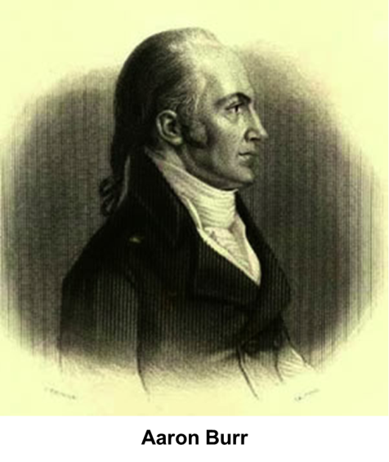
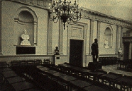
Burr Conspiracy
Burr went west to gain control over a territory that he could lead (1806)
Went to England and Spain for support
Wanted to establish independent country in West
Governor James Wilkinson of Louisiana turned Burr in as a traitor
Burr was acquitted of treason
Chief Justice Marshall limited definition of treason to only people who make war against the US
Limits governments ability to use treason accusations against political opponents
Courthouse of Trial

Slide 16
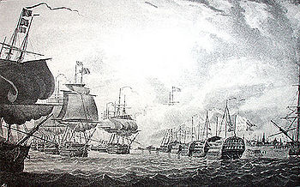
War between Britain and France
Britain and France resume war in 1803
Battle of Trafalgar established Britain as dominant naval power
Battle of Austerlitz established France as dominant land power
US had made money trading with both sides and Europe as a neutral
Both countries try to stop trade
1806 – Orders in Council passed by Britain that closed all European ports to trade (including American)
Stop and attack American ships
France ordered seizure off all ships from British ports (including American)
British sailors became naturalized Americans for better pay, food and treatment
British would board American ships and force American sailors into British navy (impressment)
US claimed more than 6,000 Americans had been taken between 1808-1811
Battle of Copenhagen 1807

Slide 17
Chesapeake Affair (1807)
British ship Leopard demanded America surrender 4 sailors; Chesapeake Commander James Barron refused
British ship Leopard fired at American ship Chesapeake ,
Killed 3 and wounded 18
boarded ship and took 4 American sailors off the coast of Virginia
Jefferson demanded apology for Chesapeake incident
British apologized, but kept right to search and impressment of sailors

Slide 18
Embargo Act of 1807
US too weak to fight either France or England
Jefferson’s opposition to military spending left America too weak to fight either Britain or France
Embargo Act passed to stop American trade with Europe
US hoped Europe’s need for American raw materials and food would force France and England to change policies
Jefferson was trying to show new way of diplomacy without fighting
Hurt American economy more than France or England
Britain traded with Latin America, France supplied from Europe
Westerners wanted US to go to war with England
Embargo hurt Democrat-Republican political power
Opponents believed law was tyrannical. Federalists increased in power
Was very unpopular
Encouraged local manufacturing, not Jefferson’s base
March 1809 Act was repealed replaced by Non-intercourse Act
forbade trade only with England and France until they respect US neutrality

Slide 19
James Madison
Kept notes of Constitutional Convention
Adviser to George Washington
Helped build Democrat-Republican party with Thomas Jefferson
Elected President 1808
Non-intercourse Act expired in 1810
Macon’s Bill No. 2
Bill allowed President to cut off trade with either Britain or France if the other lifted trade restrictions
Madison opposed it because he believed it made US look weak
Napoleon agrees to lift restrictions
Madison forbid trade with Britain but allows with France in hopes that it would force Britain to repeal the Orders of Council reopening Atlantic trade
Britain did not repeal Orders of Council, they knew US needed British trade
US forced into reestablishing Embargo, which ended US neutrality in Anglo-France Napoleonic war.

Slide 20
War Hawks
Typically were new members of government from South and West
Very Nationalistic
Favored military response over diplomacy
Favored US government purchasing lots of cheap land
easier to farm with
Would force Indians off land
Believed Indian resistance was led by Britain and Spain
US government bought land, then forced Indians off land
Led to fights between whites and Indians
Tecumseh and Tenskwatawa
Attempted to create a confederation of all tribes east of the Mississippi
Tenskwatawa seen as prophet, argued against Indian assimilation of white ways
led Shawnee resistance to white settlement in Northwest Territory
Offered to join Americans against British if US give back Shawnee land, US said no

Slide 21
Battle of Tippecanoe (1811)
William Henry Harrison defeated Indians in a battle at Tippecanoe and burned Tecumseh’s village in Indiana
Attack led to general war between Indians and Americans
led to British gave Indians weapons and support
Led to War Hawks call for war against Britain and to take Canada

Slide 22
War of 1812 Mr. Madison’s War
Sectional differences about war
East didn’t want war because it would hurt trade
supported Britain, not France
Did not want more agrarian states created from Canada
New England bankers loaned money to Britain and Governors would not send militia
South and West supported
West wanted Canada, South wanted Florida (Spain was allies with Britain)
Democrat-Republicans supported war, Federalists opposed it
President Madison declares war June 1, 1812
Fought because of British impressments, blockades and inciting Indians
Needed war to prove viability of US nation and democracy as government
Believed US needed to eliminate Canadian support for Indians
Expected a quick war

Slide 23
Avoidable War
British economy was beginning to suffer from the American boycott and Napoleon’s blockade of Britain
America declared war when Britain was finally ready to repeal Orders of Council
US thought war would be short
US had bigger population than Canada
Britain was fighting France
Britain was stronger than US thought
Canadian army same size as American
British Naval forces significantly stronger

