Slide 1
1912:
The Election
that Changed
the Century
Mr. Walters
Chapter 29

Slide 2
The
Candidates

Slide 3
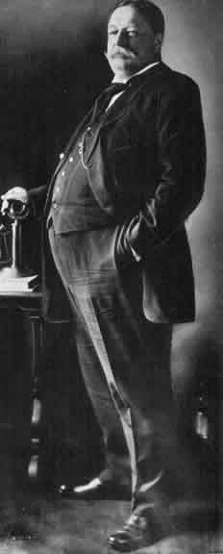
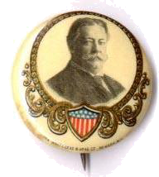
The Republican Party & President William H. Taft

Slide 4
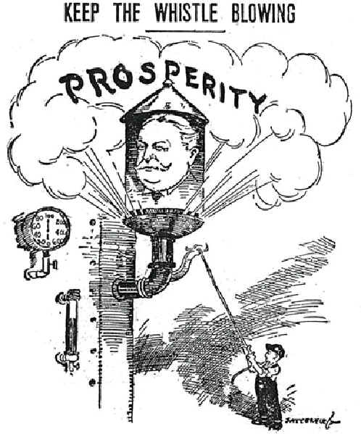
Keep the Whistle Blowing
Taft was determined to defeat TR and preserve the conservative heart of the Republican Party.

Slide 5
Republican Party Platform
High import tariffs.
Put limitations on female and child labor.
Workman’s Compensation Laws.
Against initiative, referendum, and recall.
Against “bad” trusts.
Creation of a Federal Trade Commission.
Stay on the gold standard.
Conservation of natural resources because they are finite.

Slide 6
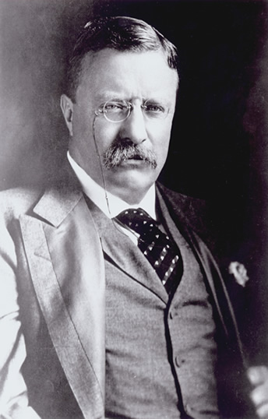
The Progressive Party & Former President Theodore Roosevelt
People should rise above their sectarian interests to promote the general good.

Slide 7
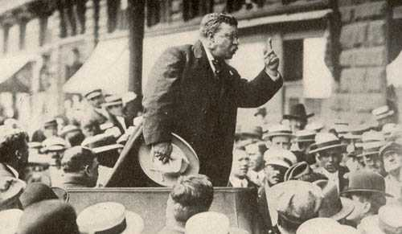
Theodore Roosevelt at Osawatomie, KS: New Nationalism
Big business requires big government.

Slide 8
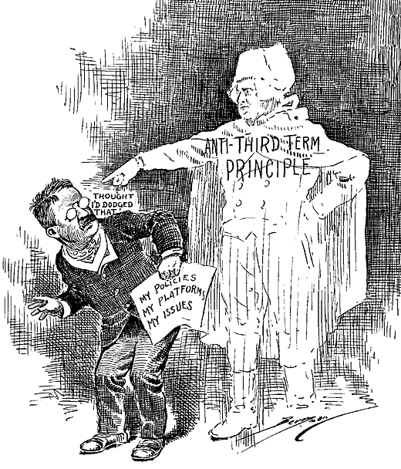
The Anti- Third-Term Principle

Slide 9
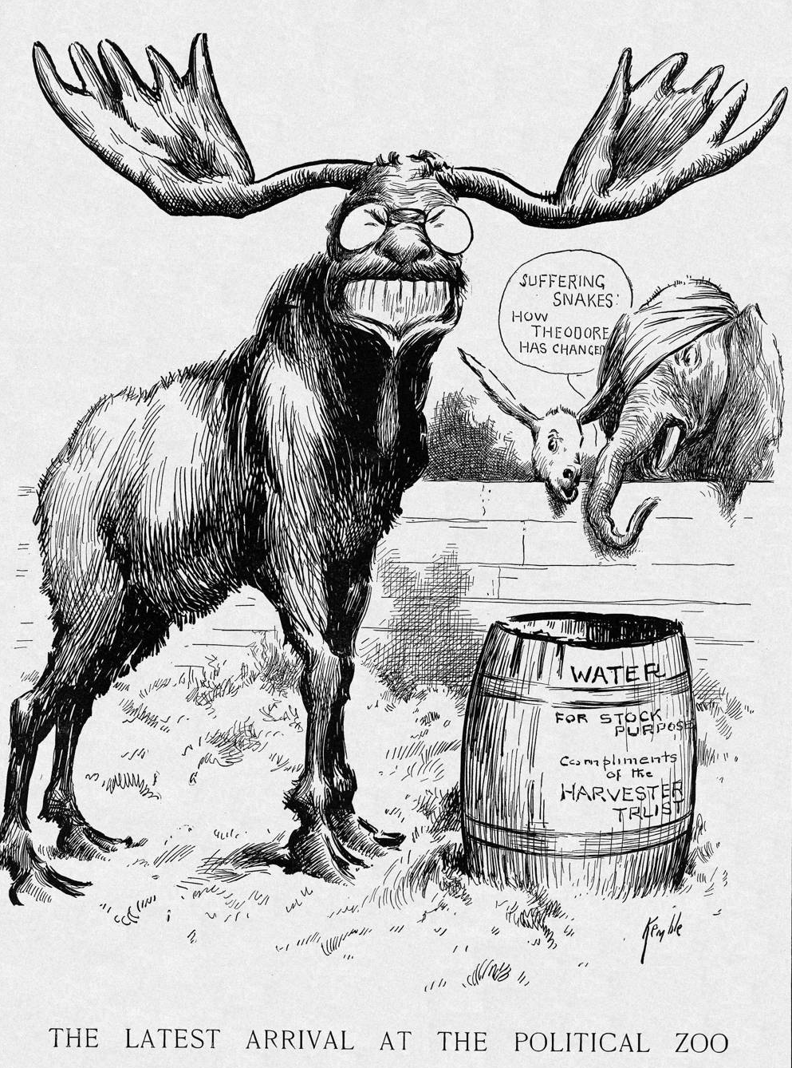
The “Bull Moose” Party: The Latest Arrival at the Political Zoo
We stand at Armageddon, and we battle for the Lord!
ONWARD, CHRISTIAN SOLDIERS!

Slide 10
Progressive Party Platform
Women’s suffrage.
Graduated income tax.
Inheritance tax for the rich.
Lower tariffs.
Limits on campaign spending.
Currency reform.
Minimum wage laws.
Social insurance.
Abolition of child labor.
Workmen’s compensation.
N e w N a t i o n a l i s m

Slide 11
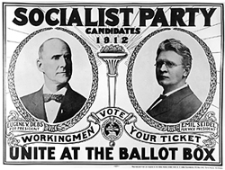
The Socialist Party & Eugene V. Debs
The issue is Socialism versus Capitalism. I am for Socialism because I am for humanity.

Slide 12
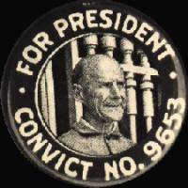
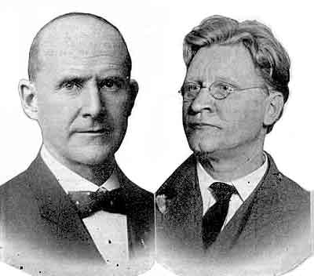
“The Working Class Candidates”
Eugene V. Debs Emil Seigel for President for Vice-President

Slide 13
Socialist Party Platform
Government ownership of railroads and utilities.
Guaranteed income tax.
No tariffs.
8-hour work day.
Better housing.
Government inspection of factories.
Women’s suffrage.

Slide 14
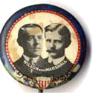
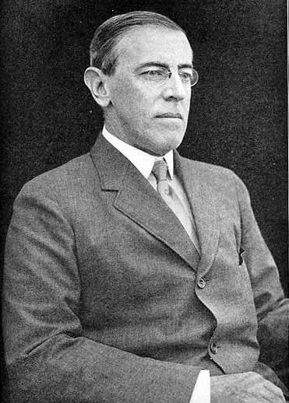
The Democratic Party & Governor Woodrow Wilson (NJ)
Could he rescue the Democratic Party from “Bryanism”??

Slide 15
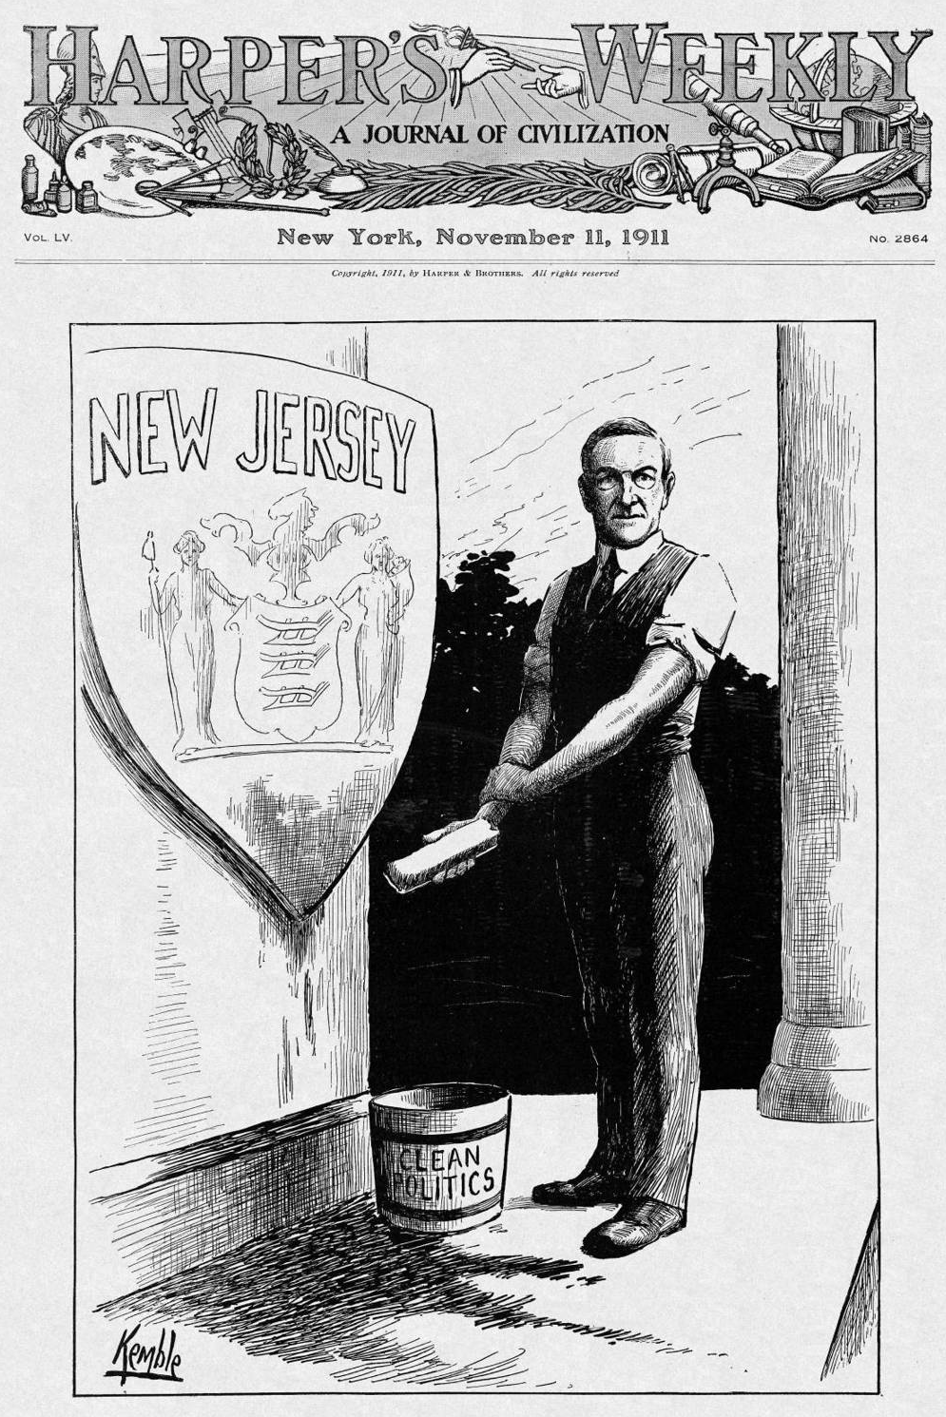
The Reform Governor of NJ: It Takes Time to Remove the Grime

Slide 16
Democratic Party Platform
Government control of the monopolies → trusts in general were bad → eliminate them!!
Tariff reduction.
One-term President.
Direct election of Senators.
Create a Department of Labor.
Strengthen the Sherman Anti-Trust Act.
Did NOT support women’s suffrage.
Opposed to a central bank.
Ne w F r e e d o m

Slide 17
The
Key
Issues

Slide 18
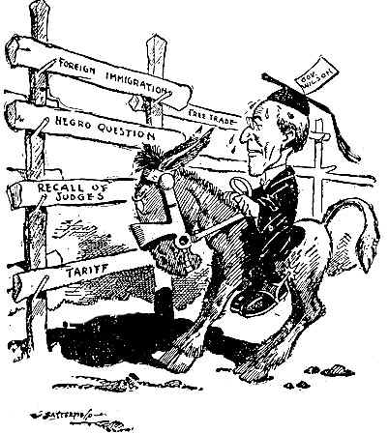
Up Against the Hurdles

Slide 19
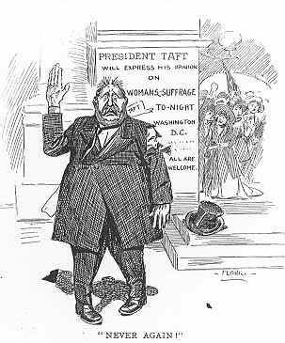
Never Again!
Taft Abandons Support for Women’s Suffrage

Slide 20
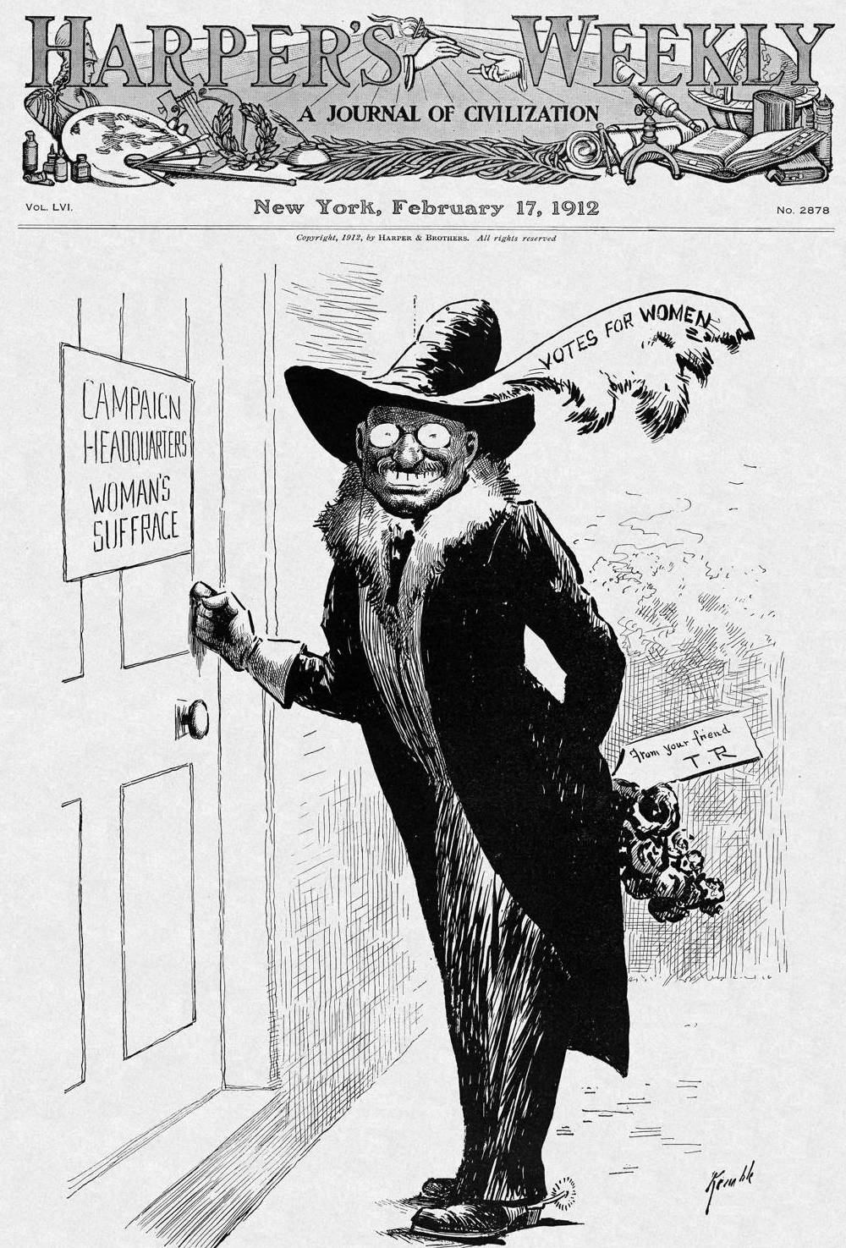
TR & Women’s Suffrage:
The Militant Recruit

Slide 21
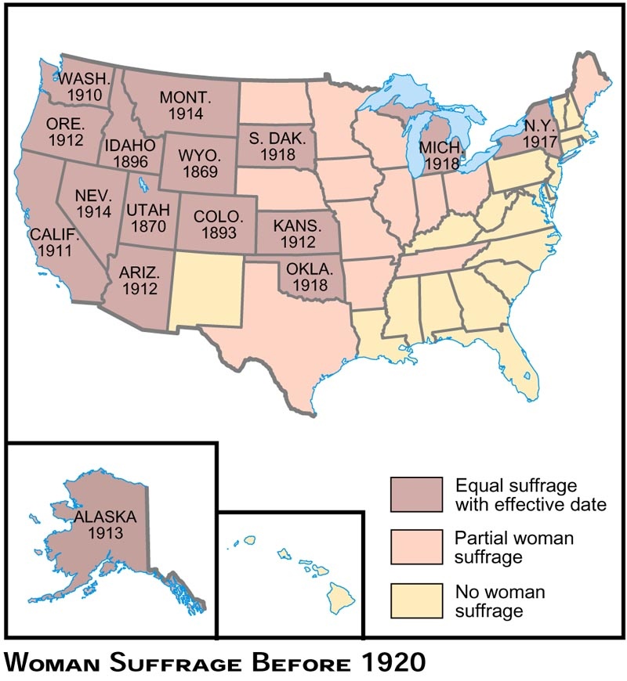
Woman Suffrage Before 1920

Slide 22
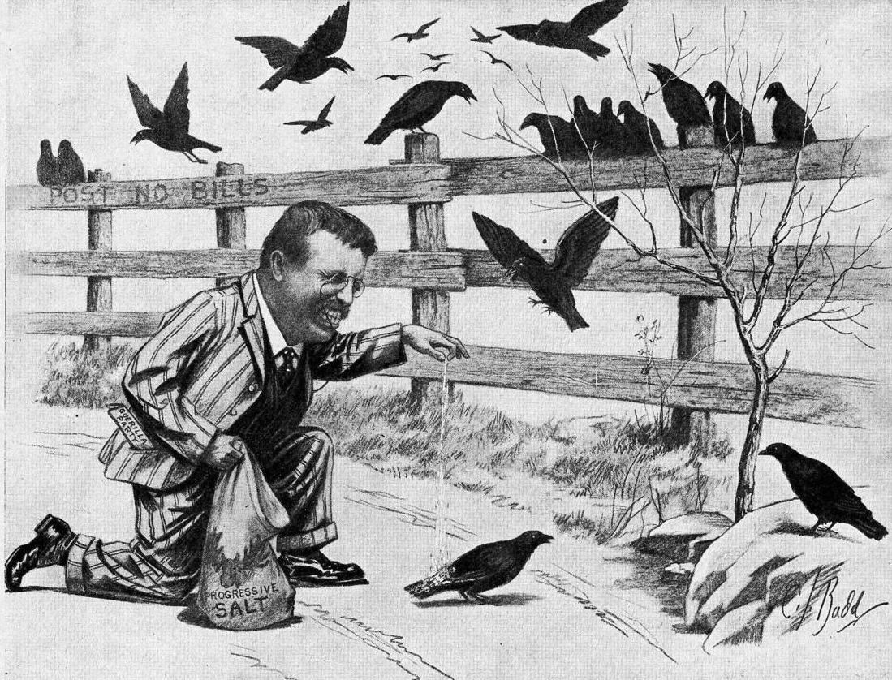
Trying to Catch the Colored Vote

Slide 23
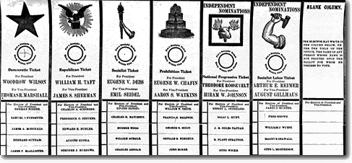
An Actual 1912 Ballot

Slide 24
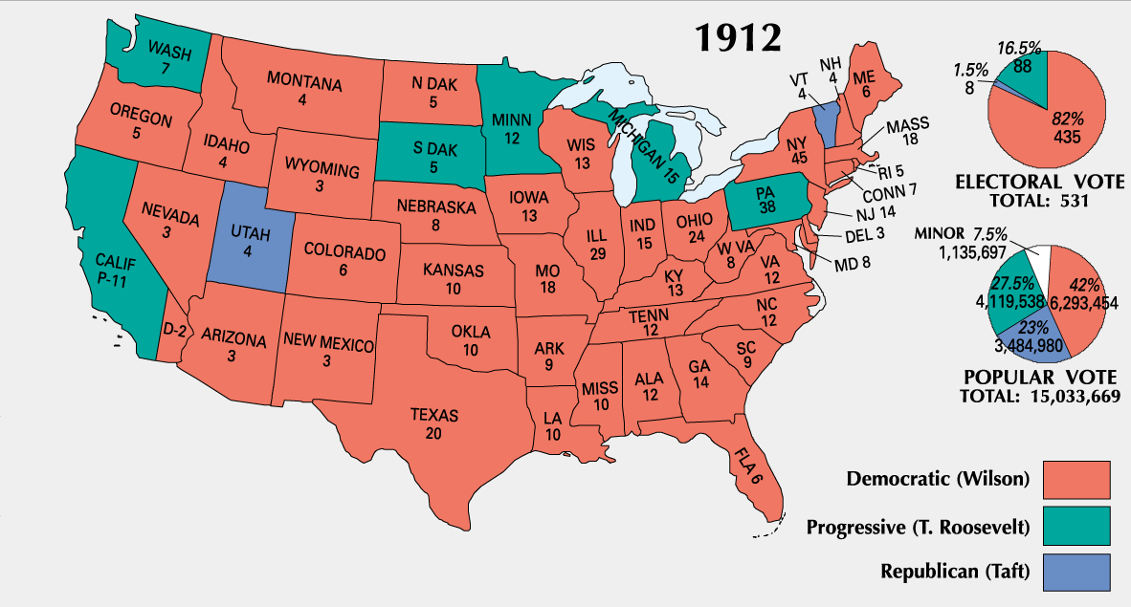
Election Results
By 1912, 100,000 fewer people had voted for Wilson than had voted for Bryan in 1908.
The 1912 election marked the apogee of the Socialist movement in America.

Slide 25
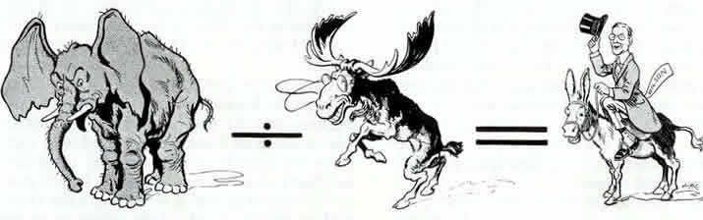
GOP Divided by Bull Moose Equals Democratic Victory!

Slide 26
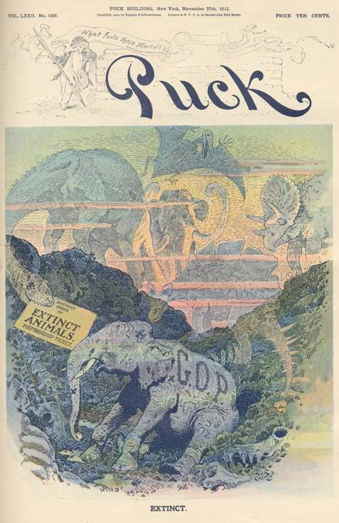
The GOP:
An Extinct Animal?

Slide 27
How did the election of 1912
change politics in America
for the rest of the 20c?

