Slide 1
T.R.’s SQUARE DEAL
He pursued the "three C's":
(1) control of the corporations,
(2) consumer protection
(3) conservation of natural resources.
A strike took place in 1902 at coal mines of Pennsylvania.
Coal supplies dwindled and the nation felt the effects of the coal shortage so TR called in strike workers to the White House.

Slide 2
Roosevelt’s Response to the Strike
R. threatened to use federal troops to operate the mines.
Roosevelt called on Congress to form the Dept. of Commerce and Labor, which it did.
The Bureau of Corporations would investigate interstate trade and become important for breaking up monopolies during the "trust-busting" days.

Slide 3
Interstate Commerce Act Weakens
The Interstate Commerce Commission (1887) had been designed to regulate railroads but it was proving to be ineffective.
Therefore, it was decided more needed to be done. Congress passed the Elkins Act in 1903.
It banned and prosecuted rebates awarded by railroaders.
The Hepburn Act
placed restrictions on free passes handed out by railroads (usually to the press to ensure good reports).

Slide 4
Roosevelt As a Trust Buster?
TR concluded, however that there were "good trusts" and there were "bad trusts."
The bad trusts had to go.
In all, Roosevelt attacked some 40 trusts.
Despite his reputation as a trust buster, TR allowed the "good trusts" to survive.
He believed his actions against the bad trusts would prevent the good ones from going astray.

Slide 5
Taft: The Real Trust Buster

Slide 6
Protecting the Consumer
The Pure Food and Drug Act was also passed.
Its goal was to ensure proper labeling of food and drugs and to prevent tampering.
These acts would help Europe to trust American meat and thus help exports.

Slide 7
Earth Control
Americans had long considered their natural resources inexhaustible.
By about 1900, they were realizing this was not true and that conservation was needed.
Acts of Congress began preserving the land…

Slide 8
Conserving the land
The Forest Reserve Act (1891) gave the president permission to set aside land as parks and reserves.
Millions of acres of old-growth forests were preserved under this authority.
The Carey Act (1894) gave federal land to the states to protect.

Slide 9
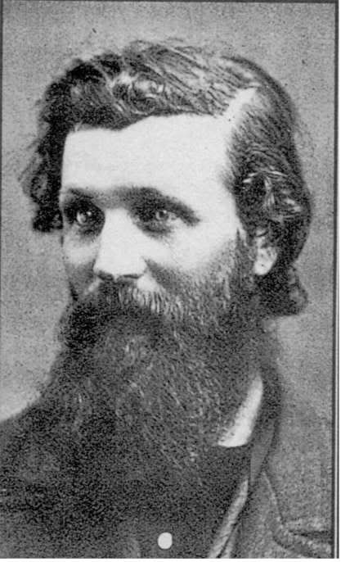
Roosevelt’s Presidency: Era of Conservancy
Others helped Roosevelt in the push to conserve, notably conservationist and Division of Forest head Gifford Pinchot and naturalist John Muir, the most well-known spokesman for Mother Nature.
Pinchot
Muir

Slide 10
T.R.’s laws to protect Mother Earth
Newlands Act (1902): massive irrigation projects out West.
TR wanted to save to the trees. By 1900, only 1/4 of the nation's once-vast virgin trees still stood.
Roosevelt set aside 125 million acres of forest land (3 times the acreage of his 3 predecessors).
Purely as an example, he had no White House Christmas tree in 1902.
Roosevelt with John Muir

Slide 11
Hetchy Hetch Valley
Inside Yosemite National Park
Hetchy Hetch was a beautiful Gorge that John Muir and the Sierra Club wanted to save.
San Francisco wanted to dam it up for the city's water supply.
In this case, TR sided with the city.
The division was clearly shown. The question asked, "Should land be simply set aside and untouched forever?" as John Muir advocated. Or, "Should the land be wisely managed for man's benefit?", as Teddy Roosevelt advocated.

Slide 12
Panic of 1907
The economy took a sudden and sharp downtown in 1907. As with any economic downtown, the president was blamed, justly or not.
Conservatives, especially, charged that Roosevelt's meddling in business had fouled up the cogs of the economy.
They called it the "Roosevelt Panic."

Slide 13
Roosevelt Legacy
Conservation
Trust busting
Good neighbor policy
Panama Canal
Great White Fleet
Reforms
Arbitration
Powers of the Presidency Increase
Brought Progressivism to the National Spotlight
Middle of the Road Capitalism, not Laissez Faire
He sought the middle-ground in between the "me alone" idea of pure capitalism and the "father knows best" ideas of a government that controls people's lives.
He showed that the U.S. was a world power and thus held great responsibilities.

Slide 14
William Howard Taft as President
In 1908, TR was still very popular. He used his popularity to endorse a candidate that had similar policies as himself—William Howard Taft.
"everybody loves a fat man"
Democrats put forth William Jennings Bryan yet again.
Bryan also painted himself as a Progressive.
Riding on TR's popularity, Taft won the election easily, 321 to 162 .
As a sign-of-the-times Socialist Party candidate Eugene Debs garnered a surprising 420,000 votes.

Slide 15
Taft: A Round Peg in a Square Hole
Taft: Mild progressive
Old guard republican
“Hands off” governing style
Not what voters thought they were getting

Slide 16
Taft’s Dollar Diplomacy
where Americans invested in foreign countries to gain power.
Wall Street was urged to invest in strategic areas, especially the Far East and Latin America.
The Dollar Diplomacy policy would thus strengthen the U.S. and make money at the same time.
Whereas TR had used the in-your-face Big Stick policy, Taft used the sneakier Dollar Diplomacy policy.

Slide 17
Dollar Diplomacy and Latin America
Monroe Doctrine forbade Europe from intervening, so the U.S. did.
The U.S. invested heavily in Honduras and Haiti. –unstable govs.
The U.S. now had a vested interest and shouldered responsibility there.
Several flare-ups required the U.S. to intervene militarily including Cuba, Honduras, the Dominican Republic, and Nicaragua (for 13 years).

Slide 18
Taft as Trust Buster
Taft was more of a trust buster than Roosevelt
Taft brought 90 lawsuits against trusts during his 4 years in office
Perhaps his most noteworthy bust was the Standard Oil Company.
The Supreme Court ordered in broken into smaller companies in 1911.
The U.S. Steel Company was under fire from Taft, even though Roosevelt had agreed to let the company survive as one of his "good trusts."
When Taft sought to break it up, Roosevelt was furious at his successor's actions.

Slide 19
Taft Splits the Republican Party

Slide 20
1910 Congress Elections
The Republican party split became apparent in the 1910 Congress election.
In the election, the old-school Republicans and Progressive Republicans split the vote, thus the Democrats won heavily in the House of Rep's.
Also, Socialist Eugene Berger of Milwaukee won a seat in Congress—again, showing the movement toward Socialism.

Slide 21
Taft-Roosevelt Rupture
The Republican split turned from differing opinions to different parties.
The National Progressive Republican League began in 1911.
Sen. Robert La Follette ("Fighting Bob" of Wisconsin) seemed destined to become their candidate.

Slide 22
Roosevelt So Upset He Will Run Again
Upset about Taft's policies that TR dropped hints that he'd be interested in running again for president.
He finally said, "My hat is in the ring!" arguing that he hadn't wanted three consecutive terms as president.
La Follette was brushed aside and Roosevelt was named as the Progressive Republican.

Slide 23
Taft-Roosevelt Showdown
As the sitting president, Taft was nominated as the Republican candidate for 1912.
Roosevelt wasn't done, however.
TR would simply run on his own as a third party candidate.
The Bull Moose Party is born

